Slide 1
What is effective communication?
for data scientists

Slide 2
What is effective communication?
Explaining something you understand to someone that does not know it, so that they understand.
Using simple English.
Using mathematical notation when it makes things simpler.

Slide 3
Psychology of effective discussion
Identifying and resolving misunderstandings / disagreements.
Keeping the communication channels open, not letting misunderstandings linger.
Having respect to the other / Not being offended.
Letting others speak / limiting your own speech.

Slide 4
Discussion in Teams
Domain expert
Math/Phyics PhD.
Methods Expert
Methods Expert
Methods Expert
Treasurer
Integration, submission Notebooks
Coding, testing,
Visualization,
Packaging, documenting
Mathematical abstractions / models
AWS Credentials
Managing Cloud Resources

Slide 5
Communication Tools
Platforms:
Conversational: eMail, Slack, Zoom
Persistent: Github, Google Drive, DropBox
Formats:
Diary – reverse chronological – a good way to keep track of you own work.
Meeting Agenda – Meeting Transcript: help keeps meeting focused and results documented.
To Do List: use order to prioritize, assign to people – responsible to complete.
In a meeting – start by assigning a scribe, who will create a shared document (paper notebook not enough).

Slide 6
The Jupyter Code development cycle
Import
Jupyter notebook
(Running cells)
Stand-alone Python code
%%writefile

Slide 7
The Jupyter Code publishing cycle
Import
Jupyter notebook
(Running cells)
Stand-alone Python code
Package in pipy
PIP Install

Slide 8
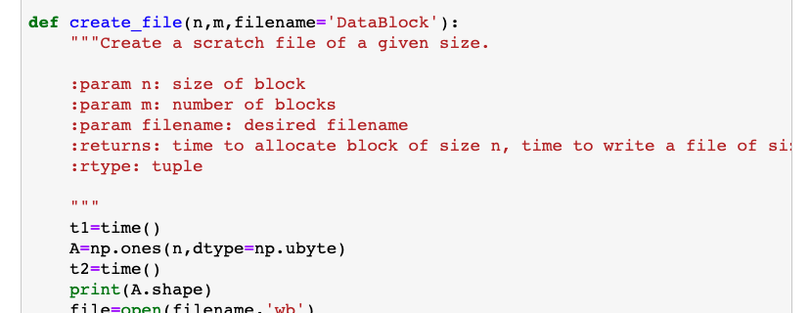
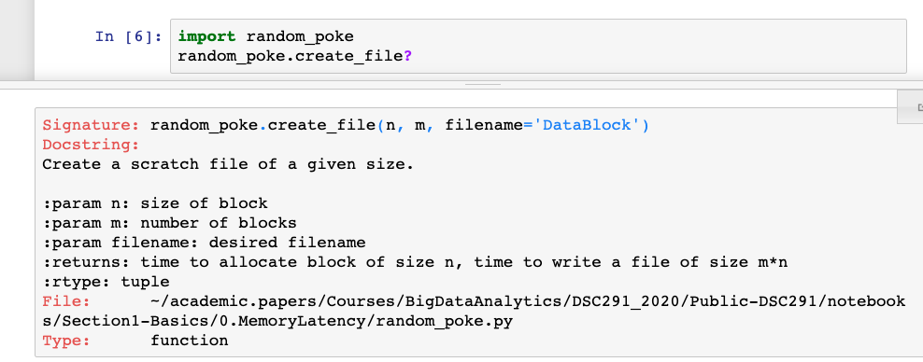
Docstrings
In-code Documentation.
Good Practice: docstring for each class and each public method.

Slide 9
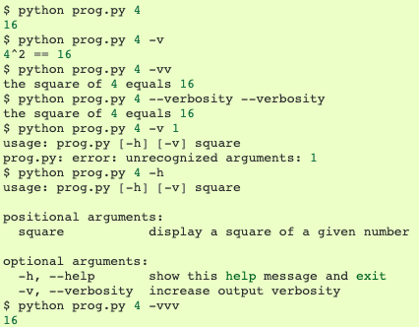
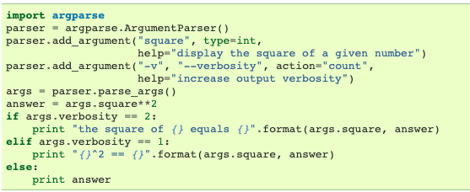
argparse
A method for organizing command line parameters.

